Slide 1

ANALYSIS ON AMCAT DATA

Slide 2
About me :
I am S Deveshwaran . I am currently pursuing my final year in B.Tech in the stream of Artificial Intelligence and Data Science . I’m a results-driven passionate aficionado with a knack for harnessing the power of data and technology to drive organizational success .With foundations in Python and its use in AI and Data Science, Java, and SQL, I thrive on solving problems and developing innovative solutions .A dedicated individual with a culture of innovation and leadership.
LinkedIn Profile : www.linkedin.com/in/deveshwaran-sridharan
Github Profile : https://github.com/Deveshwaran2004

Slide 3
Business Problem :
The problems aims to set up analysis on the Eligibility test AMCAT dataset to understand how the salaries are related to the various features and how they are segregated to various graduates of various backgrounds and various engineering sectors . Understanding this will help the graduates to set their standards in the job market for higher packages
Objective :
The objective of the project is to provide deep analytical understanding on the dataset by performing EDA (Exploratory Data Analytics) and various types of it to bring out the underlying insights , patterns , relationships between single entities and multiple entities that manipulate the salary factors of a job . To reveal trends that are involved recruitment process for higher salary expectations .

Slide 4
Exploratory Data Analysis:
Data Cleaning Steps :
1. Standardized the jobcity names .
2. Removed outliers : city named “-1” and board named ‘O’ and column named ’Unnamed :0’
b. Data Manipulation Steps :
1 . Renamed DOL column to Status and catergorized it to ‘present’ and ‘left’.
2 . Mapped city names to similar city names irrespective of spelling .
2 . Converted DOJ,DOB from object datatype to datetime datatype .
3 . Introduced new features like jobstate and jobCountry .

Slide 5
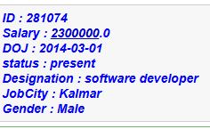
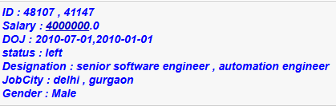
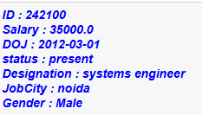
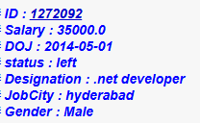
Univariate Analysis :
To proceed with the uni-variate analysis we have split the dataset based on the status {‘present’,’left’} where ‘present’ states the graduates who are currently working and the ‘left’ states the graduates who left their jobs
Status : present
Status : left
Maximum salary offered to the graduate who is still working and graduate details
Maximum salary offered to the graduate who quit and graduate details
Minimum salary offered to the graduate who is still working and graduate details
Maximum salary offered to the graduate who quit and graduate details

Slide 6
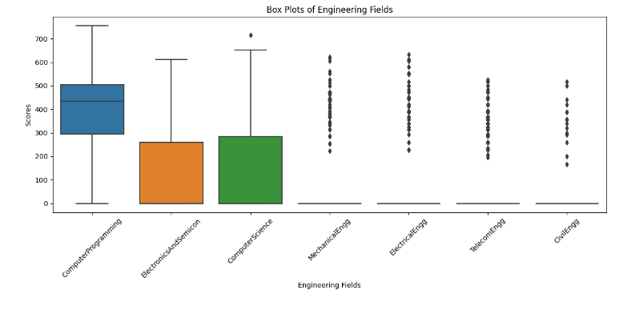
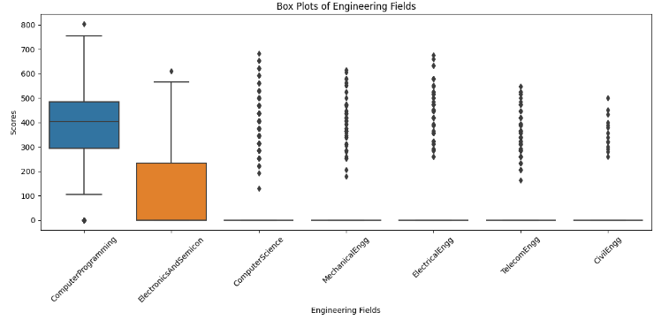
Status : present
From this plot we can understand that Computer Programming seems to have no outliers and the performance of the graduates in computer programming is good with an median score of about 450 . In rest of the other engineering fields most of the graduates seem to have scored 0 .
This leads us to conclusion like
1 . the subject was difficult
2 . the graduates were not efficient in these streams and belonged to different streams and had no idea about these streams
3 . They didn't prepare well
Status : left
From the above boxplot we can understand that the scores of the graduates who left seems to be similar to the visualizations and understandings of the currently working graduates (present) and over here for (left) status are similar .
In computer programming there seems to be one student who scored 800 and one who has failed by scoring a 0.
Most other engineering fields seems to have graduates failed in it with least marks and few which are outliers as they are exceptional cases

Slide 7
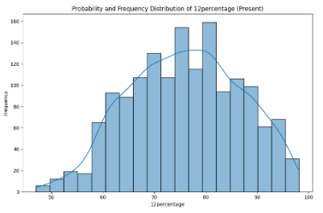
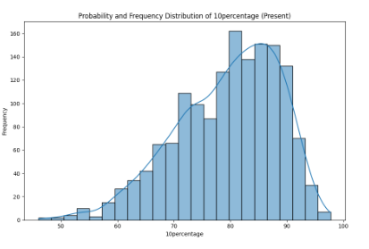
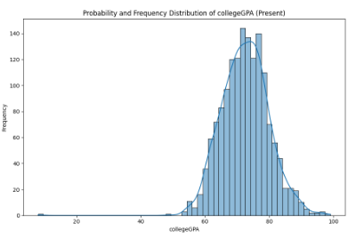
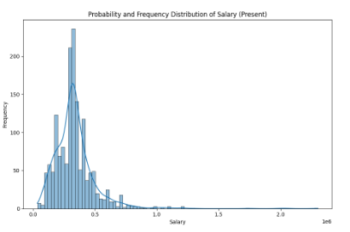
The Frequency and probability distribution (Status : present )
The Frequency and probability distribution for the following :
(*) 12th percentage : depicts symmetric skew and it is normally distributed .
(*) 10th percentage :
Depicts left skewed nature
(*) College GPA :
Depicts slight left skew
(*) Salary : depicts positive right skewed
12th percentage
10th percentage
College GPA
Salary

Slide 8
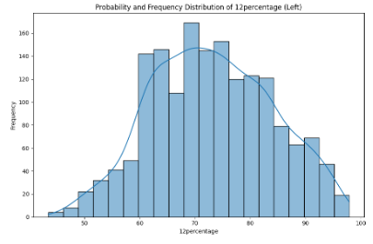
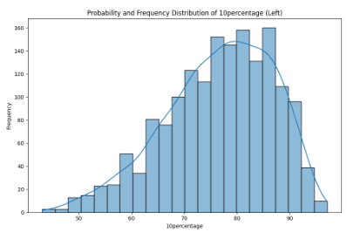
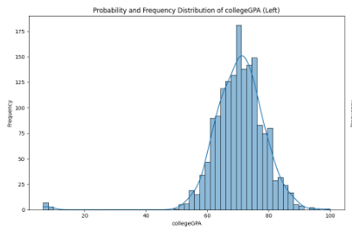
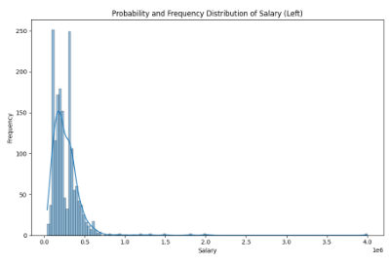
The Frequency and probability distribution (Status : left )
The Frequency and probability distribution for the following :
(*) 12th percentage : depicts symmetric skew and it is normally distributed .
(*) 10th percentage :
Depicts left skewed nature
(*) College GPA :
Depicts slight left skew
(*) Salary : depicts positive right skewed
12th percentage
10th percentage
College GPA
Salary

Slide 9
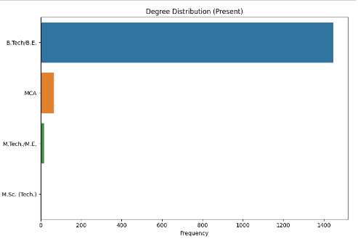
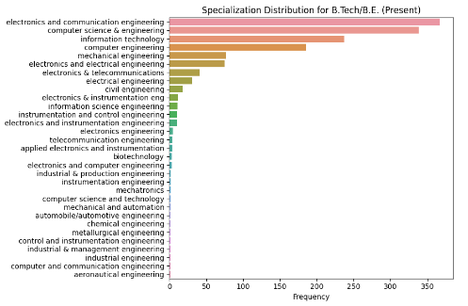
The Frequency distribution of categorical columns (Status : present )
B.Tech /B.E. graduates seems to be on the highest count when compared to MCA and M.Tech/M.E. graduates .
MCA graduates seem to be the second highest .
The Top 5 specializations under B.tech/B.E. belonged to the
Electronics and communication engineering
Computer science and engineering
Information technology
Computer engineering
Mechanical engineering

Slide 10
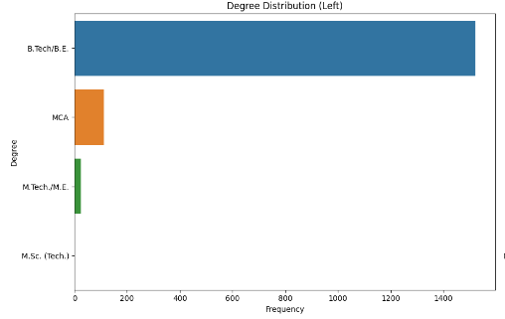
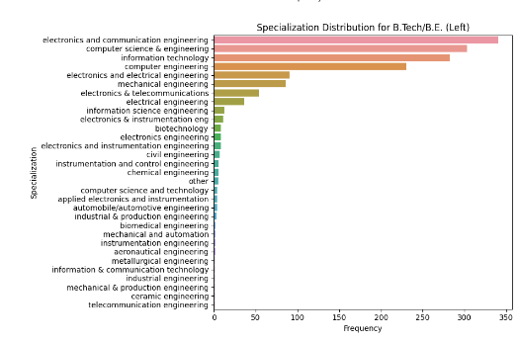
The Functional and probability distribution (Status : left )
B.Tech /B.E. graduates seems to be on the highest count when compared to MCA and M.Tech/M.E. graduates .
MCA graduates seem to be the second highest .
The Top 5 specializations under B.tech/B.E. belonged to the
Electronics and communication engineering
Computer science and engineering
Information technology
Computer engineering
Electronics and electrical engineering

Slide 11

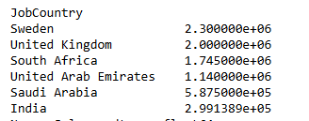
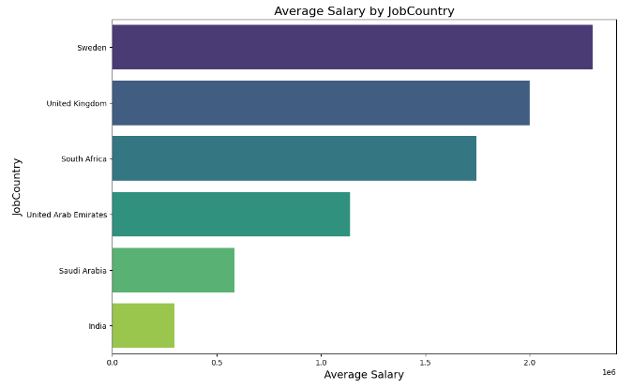
Bivariate Analysis :
Graduates in Sweden seem to earn more in terms of salary
India graduates seem to earn the least

Slide 12
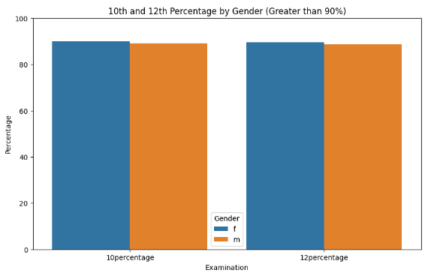
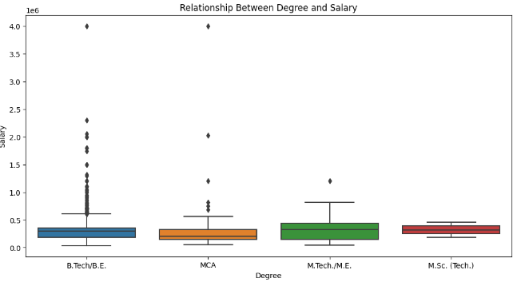
The count plot depicts the count of male and female who scored more than 90 percent in 10th and 12th and from the visualization the count of men seem to be more than for both the cases than women
we can understand that M.Tech/M.E graduates seem to earn more salary when compared to the others. B.tech/B.E and M.Sc(Tech) graduates seem to earn on the same level whereas the MCA graduates earn the least

Slide 13
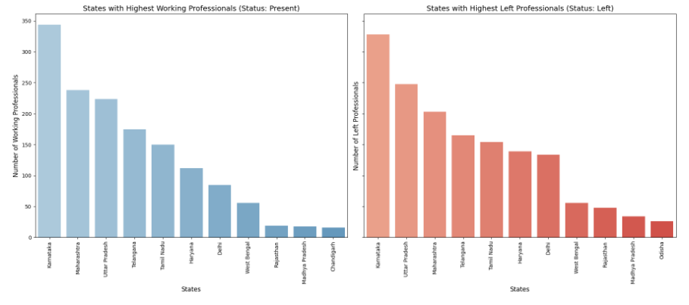
The above visualization shows the decreasing order of states with the highest count of professionals who are currently working and who have left the jobs
Karnataka seems to the state many graduates are working as well as many have left their jobs and Chandigarh is the state with the least count of working graduates and Odisha is the state with the least count of graduates who have left their job

Slide 14
Conclusion :
Thus from the project we were able to bring out all the following important analytics and insights . We were able to understand how the target variable Salary has relationship with all the other factors and features in the dataset and how relationships were created among few cases to understand them . From this analytics graduates will be able to understand what standards they have to set up for the corporate world.
Challenges :
(*) The dataset had many outliers and try to pre-process and transform them was a major task .
(*) Performing feature extraction to bring out insights from the dataset . (*) Transformation of column data had to done for certain cases inorder to proceed with the analytics
(*) Ensuring the quality of data

Slide 15


Slide 16

THANK YOU

